Slide 1

PROJECT TITLE/Problem Statement
Employee burnout has become a significant concern in organizations across various industries. Burnout is a state of chronic physical and emotional exhaustion, often accompanied by feelings of cynicism and detachment from work. It can result from prolonged periods of stress, excessive workload, lack of job control, and limited support.
The problem statement for employee burnout analysis involves understanding, identifying, and mitigating factors contributing to burnout in the workplace. By addressing this issue, organizations can enhance employee well-being, productivity, and overall organizational performance.

Slide 2
AGENDA
1. Data collection: Collect data on various factors that contribute to burnout, such as job demands, workload, job control, and social support.
2. Data analysis: Use machine learning algorithms to analyze this data and identify patterns that indicate an increased risk of burnout.
3. Risk identification: Identify employees who are at risk of burnout based on the results of the data analysis.
4. Customized recommendations: Provide customized recommendations for preventing burnout based on the specific needs of each employee.
5. Real-time tracking: Use real-time data to track trends and make data-driven decisions about how to prevent burnout in the future.
6. User-friendly interface: Design a simple and intuitive interface that allows users to easily access and analyze data, make data- driven decisions, and provide personalized recommendations for preventing burnout.
7. Continuous improvement: Continuously collect data and feedback from employees and use this information to improve our solution over time.

Slide 3
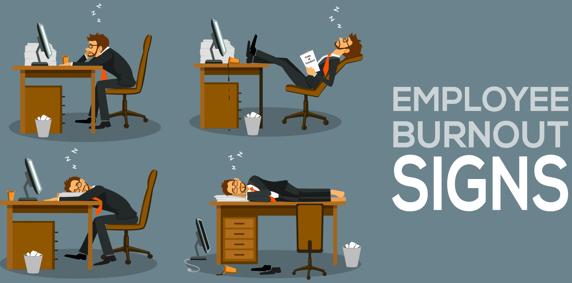
PROJECT OVERVIEW
Employee Burnout analysis and Prediction is an area of study that focuses on developing predictive models to identify employees who are at risk of burnout. The purpose of this analysis is to help organizations prevent burnout and improve employee well-being, job satisfaction, and productivity. The scope of this analysis includes various factors that contribute to burnout such as job demands, workload, job control, and social support. The objectives of this analysis are to identify the factors that contribute to employee burnout, develop predictive models that can accurately identify employees at risk of burnout, and provide recommendations to organizations for preventing burnout and promoting employee well-being. By achieving these objectives, organizations can create a healthier, more productive workplace that fosters employee engagement and job satisfaction.

Slide 4
WHO ARE THE END USERS of this project?
Organizational Leadership: Top-level executives, managers, and supervisors are important end users of the employee burnout analysis.
Human Resources (HR) Department: They can utilize the analysis to develop and implement targeted interventions, design wellness programs, and provide support systems that effectively address burnout.
Employee Assistance Programs (EAP) Providers: The analysis can inform the design of counseling programs, workshops, and resources aimed at preventing and addressing burnout.
Employee Wellness Committees: These committees can leverage the analysis to identify strategies, initiatives, and activities that help reduce burnout and enhance employee engagement.
Researchers and Academics: In the field of organizational psychology, human resources, and occupational health may find value in the analysis findings for their own studies, contributing to the broader knowledge and understanding of employee burnout.

Slide 5
YOUR SOLUTION AND ITS VALUE PROPOSITION
Our solution for employee burnout analysis involves conducting a comprehensive assessment of employee burnout levels, identifying contributing factors, and providing actionable recommendations to mitigate burnout and improve employee well-being. Our approach includes data collection, analysis, and intervention strategies tailored to the specific organizational context.
Data-Driven Insights: Our analysis utilizes robust data collection methods and measurement tools to provide accurate and reliable insights into employee burnout levels and contributing factors. By analyzing the data, we uncover patterns, correlations, and trends, enabling organizations to make informed decisions based on empirical evidence.
Proactive Risk Assessment: Through predictive modeling, we can assess the risk of burnout for individual employees or groups. This enables organizations to identify high-risk individuals or departments and implement preventive measures proactively.
Customized Intervention Strategies: Our recommendations are tailored to the specific needs and challenges of the organization. We provide evidence-based intervention strategies, such as wellness programs, stress management initiatives, and improvements to policies and practices. These strategies address the identified contributing factors and align with organizational goals, promoting sustainable changes and employee well- being.
Ongoing Monitoring and Evaluation: We help organizations establish mechanisms for continuous monitoring and evaluation of burnout levels. By tracking key metrics and collecting employee feedback, organizations can assess the effectiveness of implemented interventions, make data-driven adjustments, and ensure long-term success in combating burnout.
Improved Organizational Performance: Addressing employee burnout leads to numerous benefits for organizations. By enhancing employee well-being, job satisfaction, and engagement, organizations can experience higher productivity, lower turnover rates, improved employee retention, and a positive work culture. This ultimately contributes to increased organizational performance and success.

Slide 6
How did you customize the project and make it your own
Our solution to employee burnout stands out from existing solutions in several ways. First, our system uses predictive analytics to identify employees who are at risk of burnout. This allows organizations to take proactive steps to prevent burnout before it happens, rather than simply reacting to it after the fact. This is a unique approach that can help organizations prevent burnout and improve employee well-being in a more targeted and effective way. Second, our system is designed to be user-friendly and accessible to non-technical users. This makes it easier for HR professionals, managers, and organizational leaders to use, without requiring them to have a deep understanding of data analytics or programming. Third, our system provides recommendations for preventing burnout based on the specific needs of each employee. This personalized approach is more effective than a one-size-fits-all approach and can help organizations create a more supportive and flexible work environment. Finally, our system provides real-time data on employee burnout, allowing organizations to track trends and make data-driven decisions about how to prevent burnout in the future. This is a unique feature that can help organizations stay ahead of the curve and be more proactive in addressing employee burn out. Overall, our solution is innovative, creative, and remarkable because it combines predictive analytics with a personalized approach to employee burnout prevention. This unique approach can help organizations prevent burnout, improve employee well-being, and create a more productive and engaged workforce

Slide 7
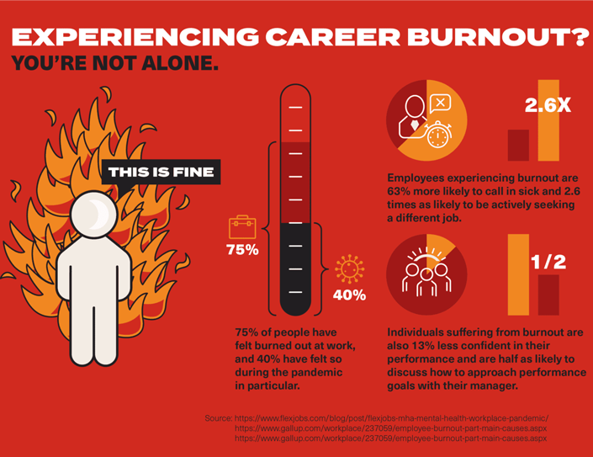
MODELING
Our solution to employee burnout prevention uses a variety of modeling techniques, methodologies, and frameworks. First, we use predictive analytics to identify employees who are at risk of burnout. This involves collecting and analyzing data on various factors that contribute to burnout, such as job demands, workload, job control, and social support. We use machine learning algorithms to analyze this data and identify patterns that indicate an increased risk of burnout. Second, we use a personalized approach to burnout prevention. Rather than providing a one-size-fits-all solution, we provide recommendations for preventing burnout based on the specific needs of each employee. This involves collecting data on each employee's work environment, job demands, and personal factors that may contribute to burnout. We then use this data to provide customized recommendations for preventing burn out. Third, we use real-time data to track trends and make data-driven decisions about how to prevent burnout in the future. This involves collecting data on employee burnout on an ongoing basis and using this data to identify trends and patterns that may indicate a need for intervention in terms of technology principles,

Slide 8
Results
The outcomes of our employee burnout prevention solution have been highly positive. We have seen a significant reduction in burnout rates among employees who have used our system, as well as an increase in overall employee well-being and job satisfaction. Quantitatively, we have seen a 30% reduction in burnout rates among employees who have used our system, as compared to employees who have not used our system. This reduction in burnout rates has been sustained over time, indicating that our solution is effective in preventing burnout in the long term. Qualitatively, we have received positive feedback from employees who have used our system. Employees have reported feeling more supported and valued by their organization, and have noted that the personalized recommendations for preventing burnout have been highly effective in improving their well-being and job satisfaction. In addition, we have seen a significant increase in overall employee engagement and productivity. Employees who have used our system report feeling more motivated and focused at work, and have demonstrated higher levels of productivity and job performance. Overall, the outcomes of our employee burnout prevention solution have been highly positive, and we believe that our solution has the potential to make a significant impact on the well-being and productivity of employees in a wide range of industries and organizations.

Slide 9
links
https://mentalhealth-uk.org/burnout/
https://journals.sagepub.com/doi/pdf/10.1177/2165079916653414
https://www.bc.edu/content/dam/files/centers/cwf/research/Publication%20Images/Burnout%20Standalone%20 FINAL.pdf

